Slide 1


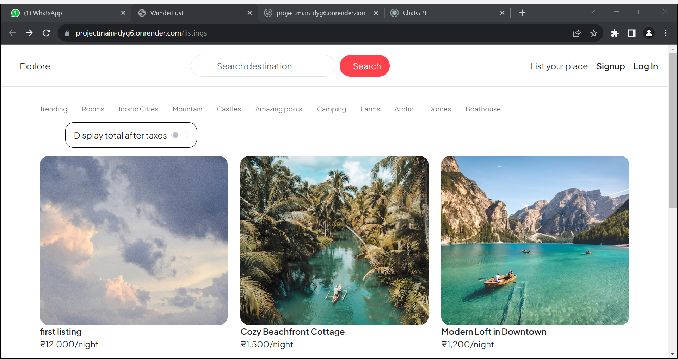
DEPARTMENT OF COMPUTER
ENGINEERING AND APPLICATIONS
Wanderlust: Your vacation rental website
Aditya Dubey
Aditya Faujdar
Aman Garg
Dhanraj Beniwal

Slide 2
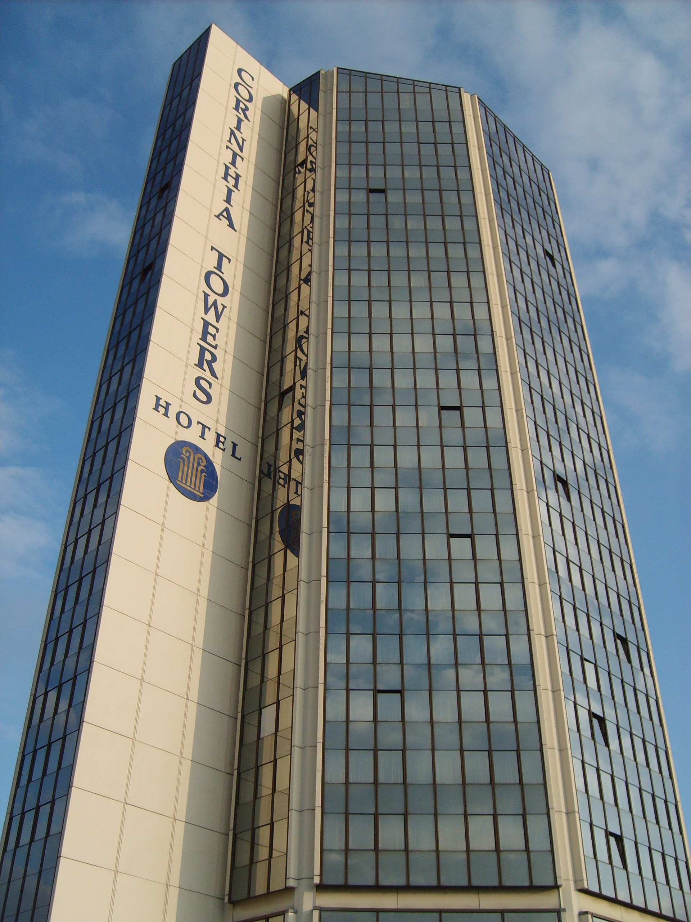
Introduction
1.
Introducing Wanderlust, a web application that helps users find affordable hotels and track prices. With a combination of cutting-edge technologies and user-friendly design, Wanderlust is the go-to platform for all your travel needs.
2.
The motivation behind the project is to provide users with a convenient and efficient way to search for hotels and track prices. With the help of wanderlust, users can easily compare prices and find the best deals available. The project is designed to be user-friendly and accessible to everyone

Slide 3

Objectives
1
Affordability
Our main objective is to help users find cheap hotels to their desired destinations.
2
Accuracy
We want to ensure that the prices displayed on wanderlust are up-to-date and accurate.
3
Convenience
By allowing users to track prices, we want to make it easier for them to plan their trips in advance.

Slide 4
Problem Statement
The Cost Barrier
Information Overload
Uncertainty
Traveling can be prohibitively expensive and many people are unable to take advantage of booking good hotels due to high prices.
With so many different hotels and room options available, it can be overwhelming and time-consuming to find the best deals.
Prices fluctuate constantly and there is no guarantee that a good deal will be available at a later date.

Slide 5
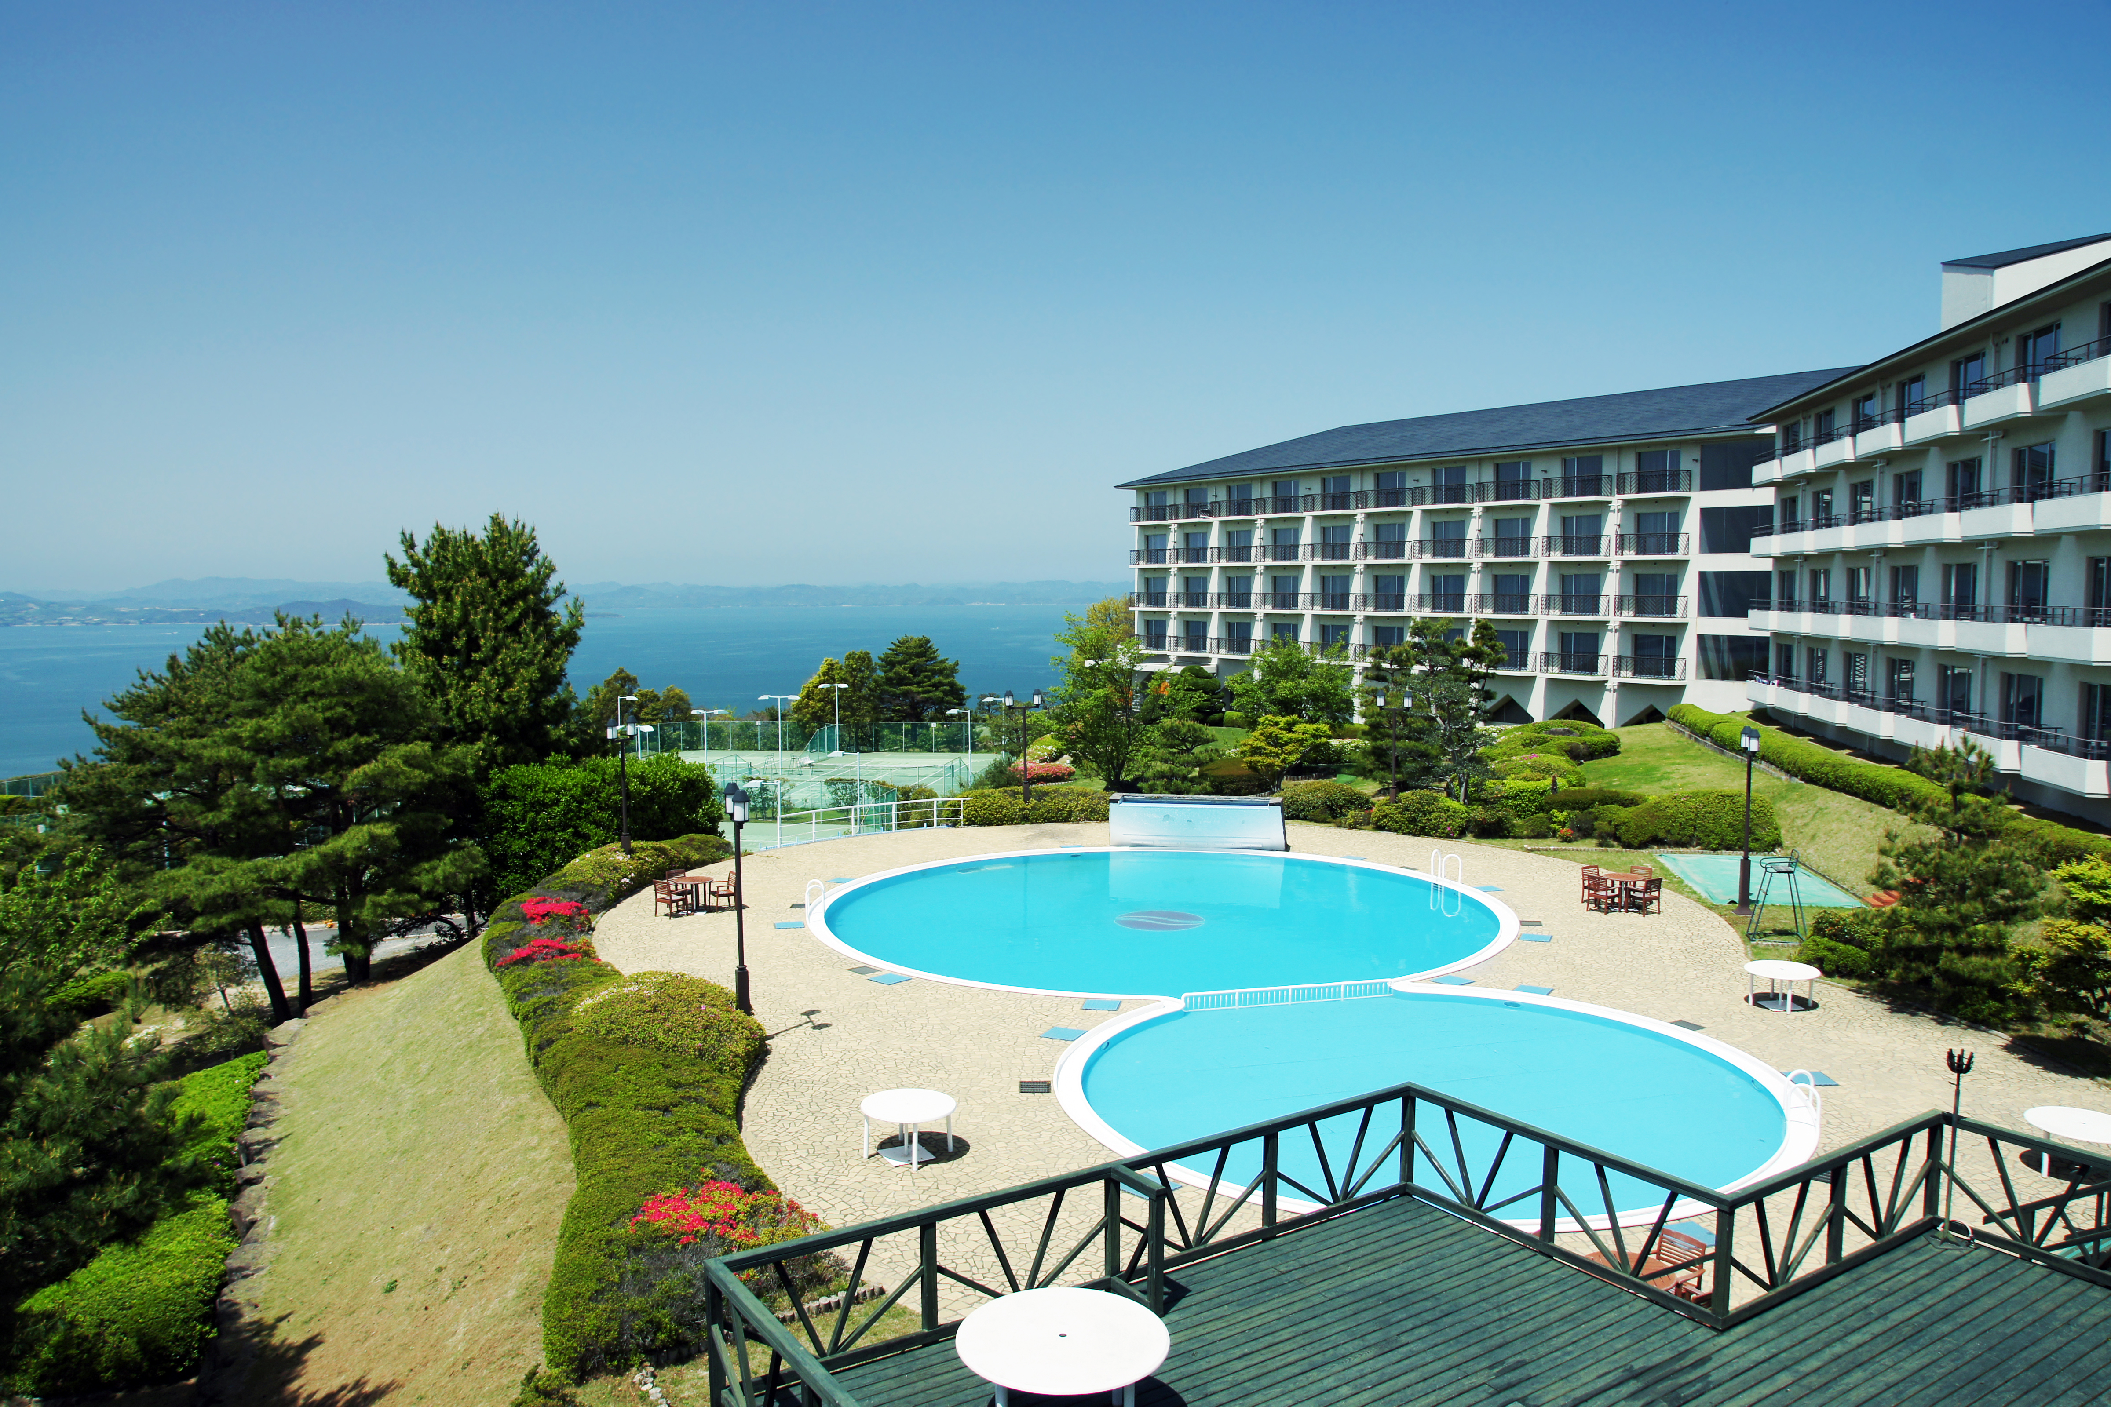
Literature Review
Wanderlust
Wanderlust is a travel platform that provides stays and hotel booking services. It has a user-friendly interface and displays a wide range of hotel options.
.
The gap that the price searching project is filling is the lack of a convenient and efficient way to search for rooms and hotel prices. With the help of Wanderlust, users can easily compare prices and find the best deals available.
The project is designed to be user-friendly and accessible to everyone .
This Photo by Unknown Author is licensed under CC BY-SA

Slide 6
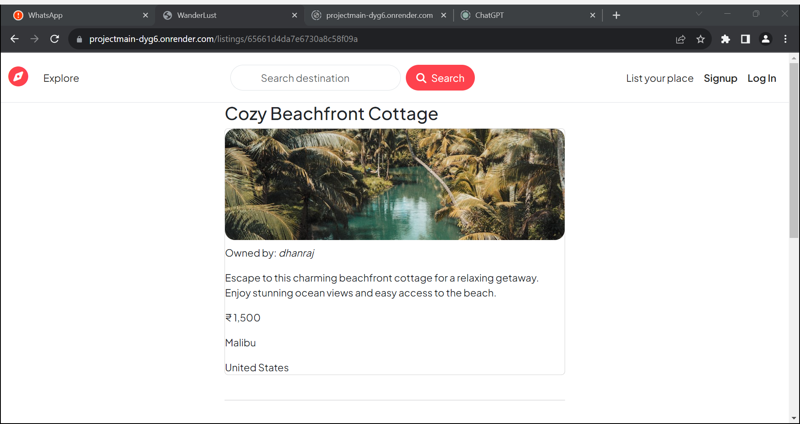

Slide 7
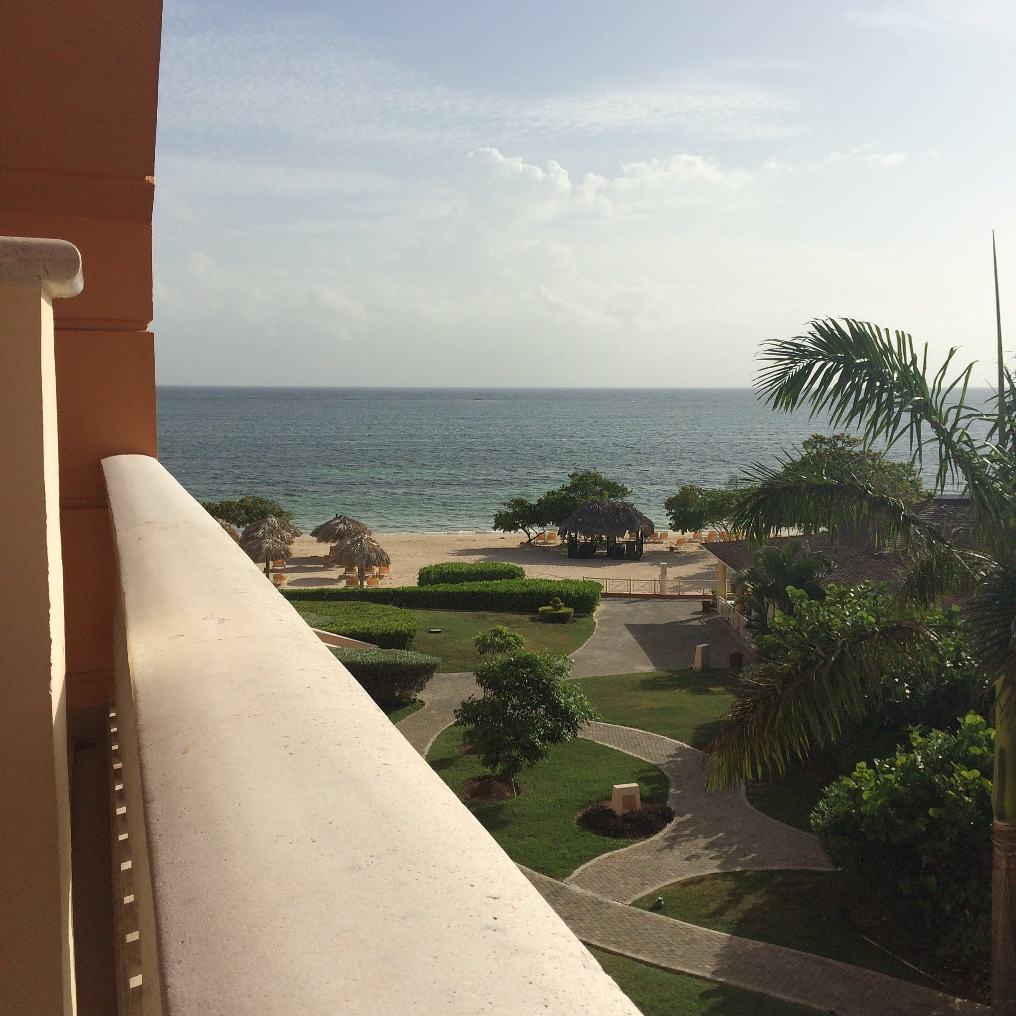

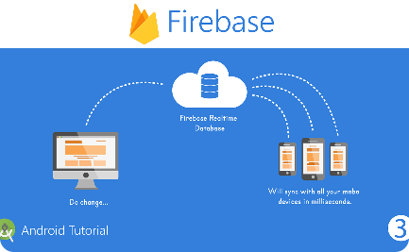
System Architecture
Client-Side
Server-Side
React, HTML, and Bootstrap-CSS provide a seamless user interface and allow users to interact with the application.
Node.js and mongodb allow for real-time data processing and ensure that users receive up-to-date hotels information.

Slide 8
Implementation
1
Front-end Design
2
Data Management
3
Server management
We followed the latest design trends and used Bootstrap-CSS to make the interface responsive and visually appealing.
We utilized Mongo db to store and retrieve data in real-time with minimal latency and maximum security.
We used render and git hub to publish the website

Slide 9
Features
Price Checking
Location
Users can check the prices of specific destination and compare with other hotels
Users can see the location by location provided by the map box
Price Alerts
Authentication
Users can set price alerts to receive notifications when fares to their chosen destination drop.
Users can register / login via their credentials (Emails , Password)

Slide 10
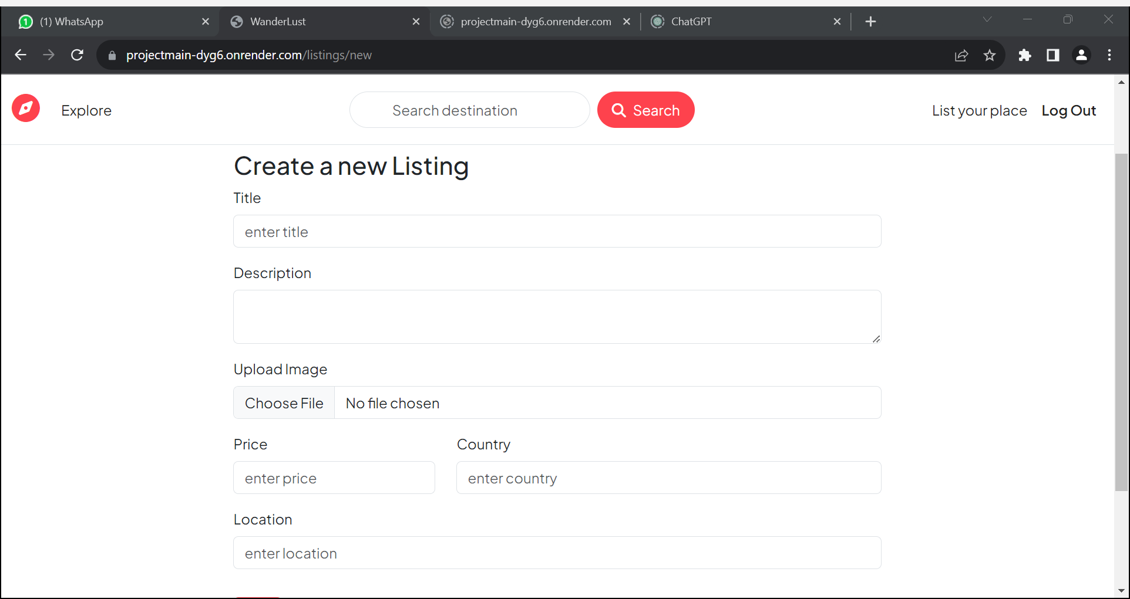
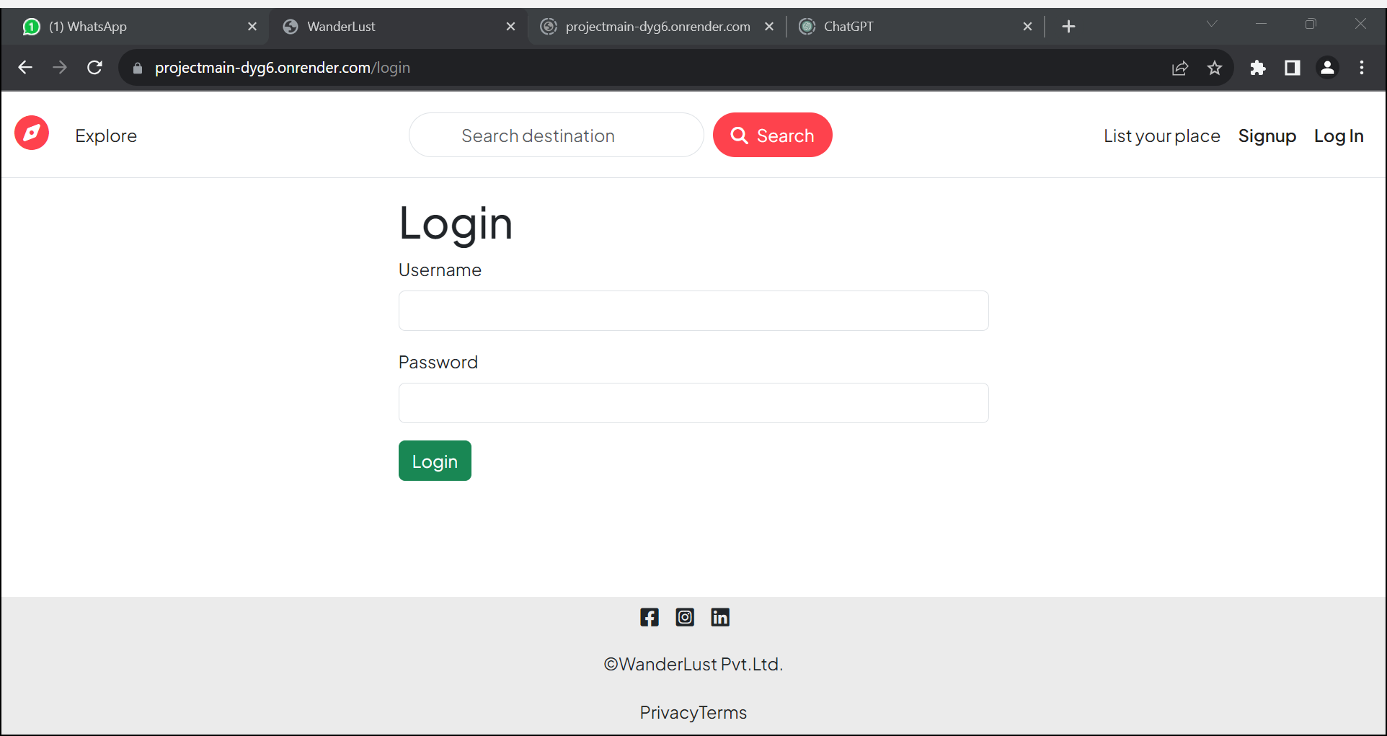
Results
The hotel project aims to provide users with a platform to search for hotels and track prices. The project is designed to be user-friendly and accessible to everyone. With the help of Wanderlust, users can easily compare prices and find the best deals available. The application will also provide notifications when prices change, ensuring that users never miss out on a good deal.The user can also add there hotels if they want to on the website to start there business and make there hotel more properly.

Slide 11

Challenges Faced
1
Data Integration
2
API
3
User Interface Design
Integrating data from multiple sources proved to be challenging, but we were able to develop a streamlined process.
Finding free testing APIs and then handling the APIs .
Connecting with the front – end to show results.
Creating a user-friendly interface that was also visually appealing required significant collaboration between our developers and designers.

Slide 12

Future Work
1
Multi-Language Support
We plan to implement multilingual support to expand our user base and cater to a wider market.
Additional Features
2
We aim to add features such as hotel and car rental booking options to further streamline the travel experience for our users.

Slide 13

Conclusion
Wanderlust is a revolutionary travel technology platform that redefines the way users discover and book hotels. With its cutting-edge algorithms, user-friendly design, and a wide range of features, wanderlust provides a seamless and stress-free travel experience.

Slide 14
Acknowledgments
We would like to express our gratitude to all the individuals and organizations who have contributed to the development of AirTracker. Your support and feedback have been invaluable in shaping the features and functionality of our hotel companion app.

Slide 15


